Slide 1


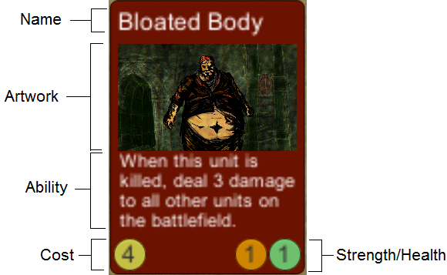

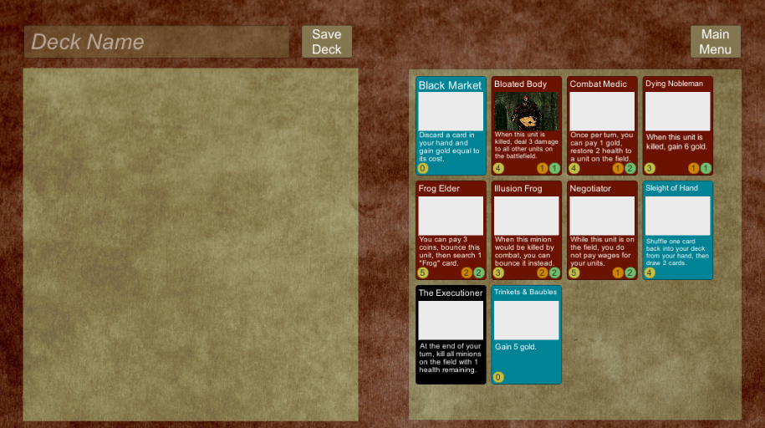
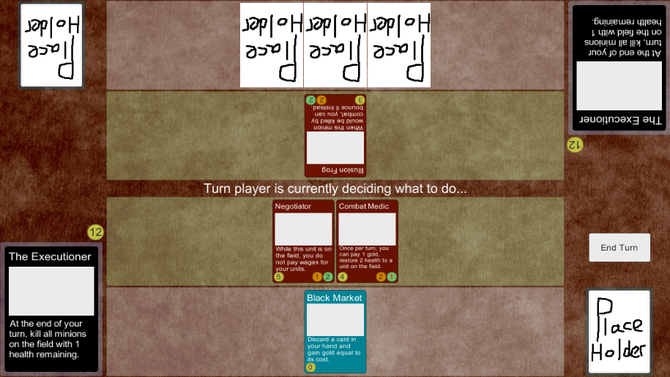

Online Deck-Building Game
Tyler Thorn
Supervisor: Joseph Walton-Rivers
Features
1-on-1 multiplayer card game with a dark fantasy theme.
Gameplay designed around resource management.
A wide variety of cards to build your deck from.
Lord cards with powerful abilities that can turn the tide of battle.

